Slide 1
Blocked-chain based Certificate Generation & Validate System
PIP2001 Capestone Project
Review-4
Batch Number: CCS-G16
Roll Number | Student Name
20211CCS0063 | Mohammed Faiz
20211CCS0072 | Sathvik u
20211CCS0104 | Venkat Teja C V
Under the Supervision of,
Dr. Nihar Rajan Nayak
Professor
School of Computer Science and Engineering
Presidency University
Name of the Program: B. Tech
Name of the HoD: Dr. Anandaraj S P
Name of the Program Project Coordinator: Dr. Sharmasth Vali Y
Name of the School Project Coordinators: Dr. Sampath A K / Dr. Abdul Khadar A / Mr. Md Ziaur Rahman

Slide 2
Introduction
Manual certificate verification is inefficient and prone to forgery.
This project uses blockchain to generate and validate academic certificates securely.
It ensures authenticity, immutability, and rapid verification for institutions and organizations.

Slide 3
Literature Review
- Blockchain for Digital Credentials
- Limitations of Traditional Certificate Systems
- Smart Contract-Based Automation
- Comparative Studies on Existing Validation Models

Slide 4
Existing Methods
- Centralized Digital Storage
- Manual Verification by Institutions
- QR-code Based Certificate PDFs
DRAWBACKS:
- Tampering risk, institutional dependency, lack of traceability

Slide 5
Objectives
- Ensure Authenticity through blockchain immutability
- Enable Instant Verification via smart contracts
- Prevent Fraud and unauthorized duplication
- Improve Efficiency through automation

Slide 6
Proposed Method
- Use Ethereum/Polygon for certificate hash storage
- Admin dashboard for uploading and tracking
- Smart contracts for validation
- IPFS for off-chain certificate storage

Slide 7
Methodology
1. Certificate Generation:
- Admin uploads certificate, hashed data recorded on blockchain
- Original stored on IPFS with reference in smart contract
2. Validation Portal:
- Scan QR or enter ID to verify from blockchain
3. Security and Access:
- Role-based secure access

Slide 8
Architecture
Components:
- Web Frontend (React/Flask)
- Smart Contracts (Solidity)
- Blockchain (Ethereum Testnet)
- IPFS Storage
- Backend Server (Node.js/Python)

Slide 9
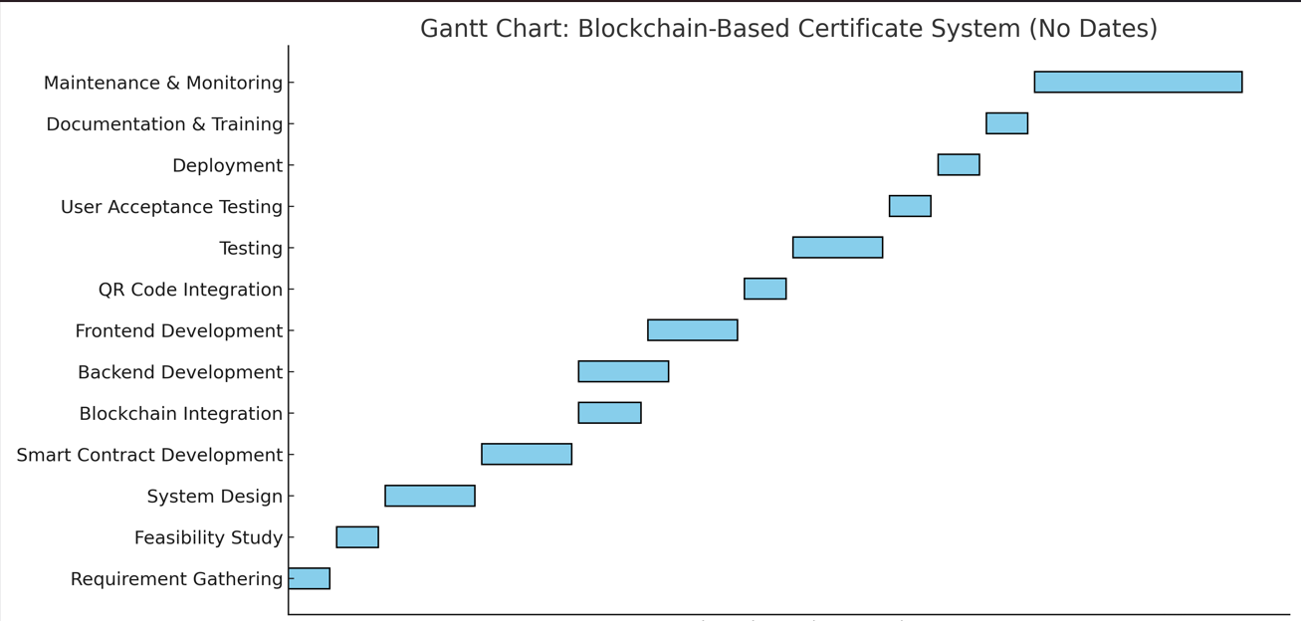
Timeline of Project

Slide 10
Outcomes
- Tamper-Proof Certificates: Immutable blockchain records
- Automated Validation: No manual checking
- Transparency & Trust: Verifiable by all stakeholders
- Scalable Solution: Supports multi-institution environments

Slide 11
Conclusion
A practical blockchain application to secure academic records.
Reduces fraud and increases efficiency.
Future work: NFT certificates and national integrations.

Slide 12
References
NIST - Guide to Industrial Control Systems (ICS) Security (SP 800-82 Rev. 3) https://doi.org/10.6028/NIST.SP.800-82r3
CISA - Mitigating Log4Shell Vulnerabilities (Alert AA21-356A) https://www.cisa.gov/news-events/alerts/2021/12/10/aa21-356a-mitigating-log4shell-and-other-log4j-related-vulnerabilities
IEEE - Challenges in Vulnerability Disclosure https://doi.org/10.1109/SP40001.2021.00001
Tenable - Vulnerability Management Whitepaper https://www.tenable.com/whitepapers
IEEE TDSC - Automated CVE Classification for Patch Prioritization https://doi.org/10.1109/TDSC.2021.3056789
OpenVAS - Vulnerability Assessment System Documentation https://www.openvas.org/documentation
Siemens ProductCERT - Security Advisories https://cert-portal.siemens.com
Scrapy - Web Scraping Framework Documentation https://scrapy.org/doc
IEEE Access - Ethical We

Slide 13

Project work mapping with SDG
This project directly supports Goal 4 (Quality Education) and Goal 9 (Industry, Innovation, and Infrastructure) by improving access to educational resources and making technology more user-friendly. It also aligns with Goal 16 (Peace, Justice, and Strong Institutions) by enhancing security, transparency, and accountability in digital environments. Indirectly, it touches on Goal 8 (Decent Work and Economic Growth) and Goal 10 (Reduced Inequalities) by improving workplace efficiency and access to technology for all staff members.

Slide 14
Thank You

